Slide 1

Developing Python code to determine the structural changes of the silica network structure in reinforced rubber
Xiaoran Wang

Slide 2
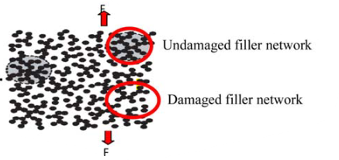
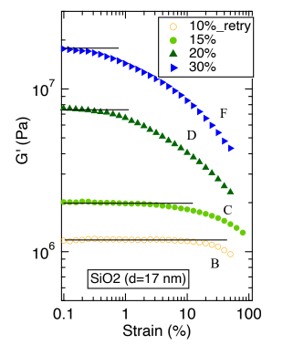
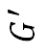
Payne Effect
A critical issue in the tire industry is the hysteresis loss of rubber, often attributed to the Payne effect
In the tire industry, one BIG concerns is the hysteresis loss of rubber which is believed due to the Payne effect.
Why the Payne effect matters for tire:
When the strain increases:
Loss of rolling resistance
Loss of elastic modulus
Payne Effect: Modulus Nonlinearity Under Strain:
1. Why is the Payne effect critical for tires?
When strain increases:
Loss of elastic modulus
Loss of rolling resistance
filler vol%
$$G^{′}$$
Why does the Payne effect matter?
Understanding Material Behavior
Improving tires Performance
Material Selection and Compound Formulation
Durability and Longevity
Cost-Efficiency
Innovation in Tire Technologies
2. The Payne effect is attributed to:
Irreversible filler-filler network breakage
Fu & Wang, Applied Polymer Science, 2016
Notes:
Payne effect is a type of strain softening phenomenon observed in filled rubber: followed after a small linear elastic regime, then the pe results in a rapid decrease in storage modulus with increasing strain
There is limited evidence to confirm this due to the lack of advanced techniques for observing structural changes in nanoscale

Slide 3
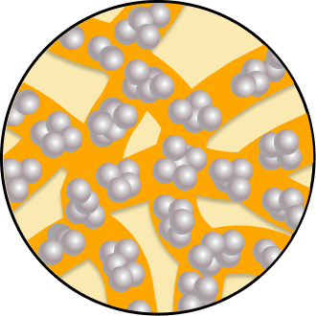
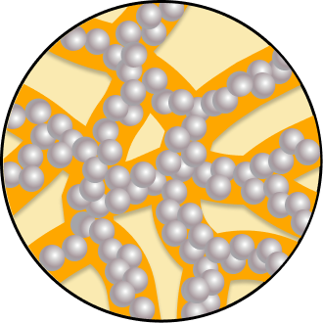
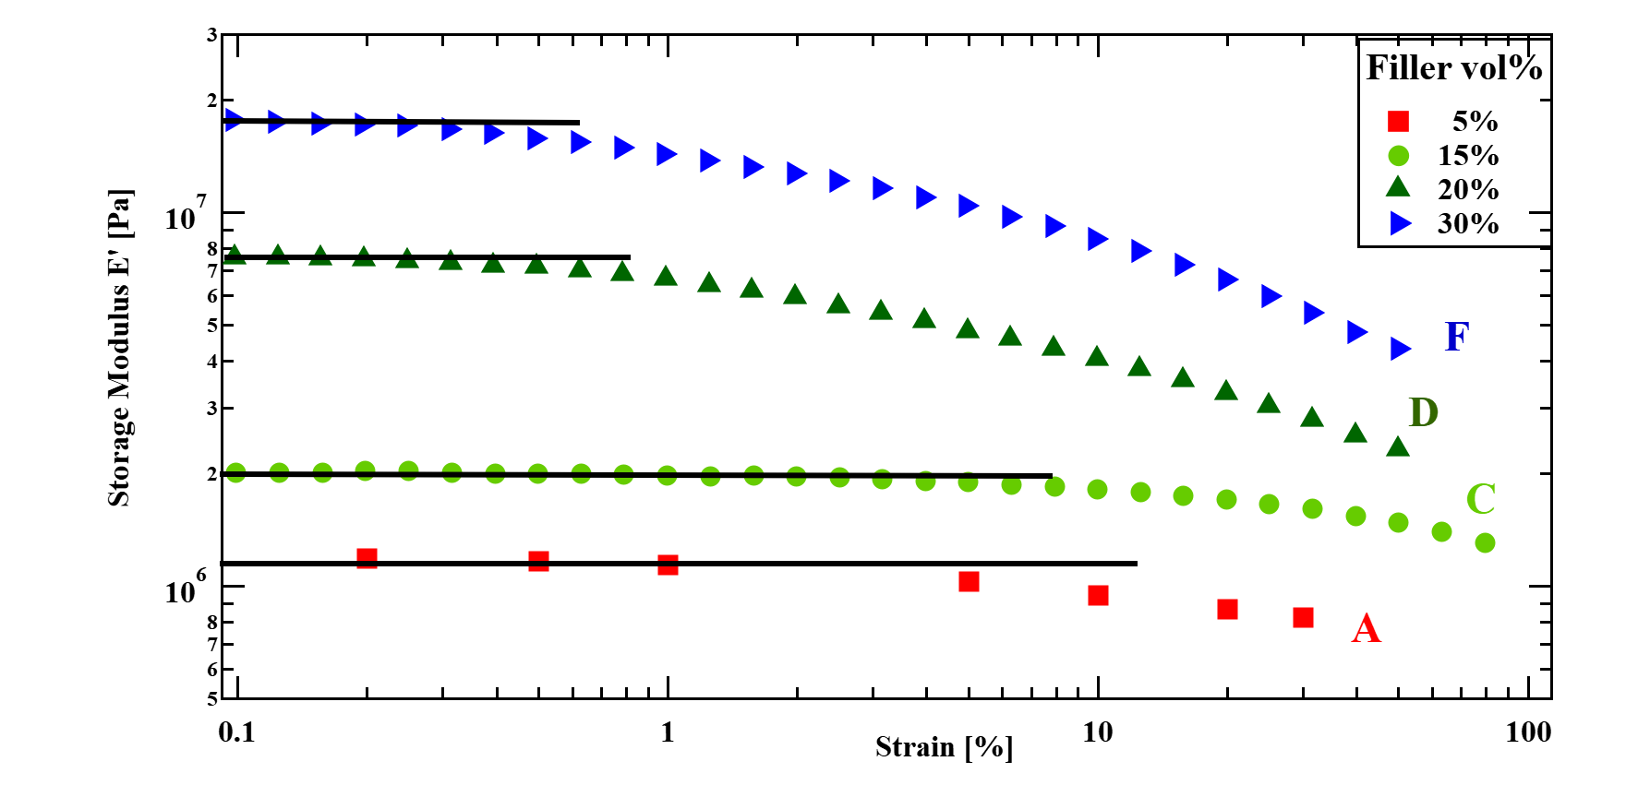
Aim
Sample name | “Network”
Filler volume fraction (%) | 20
Payne effect | Strain > 1%
Percolation | Yes
To understand the mechanism underlying the Payne effect, we performed in operando X-ray Photon Correlation Spectroscopy (XPCS) experiments under oscillatory deformation for rubber samples
Model system
Network
Percolated structure
Polymer : Polybutadiene (PB, M_{w} = 350 kg/mol, M_{w}/M_{n}=2.3, Asahi Kasei), Cross-linked
Fillers: Silica (SiO₂, filler size: 170 Å)
Silane coupling agent: Bis(triethoxysilylpropyl)polysulfide (SI69, Evonik)
In general, for rheology, G’ and E’ represent the measurement mode.
G’→ dynamic oscillation
E’ → stretching (usually use as E Young’s modulus)
I prefer to use G’ if this comes from dynamic oscillatory mode.
You used this figure in the previous page. Do you need again?
Notes:
silica (SiO₂)-filled Cross-linked polybutadiene as a rational model to study PE.
In particular, we studied the sample with 30% filler vol fraction.
We observed a significant PE when strain is greater than 1%
This sample is named as “network” based on its characteristic percolated structure formed

Slide 4
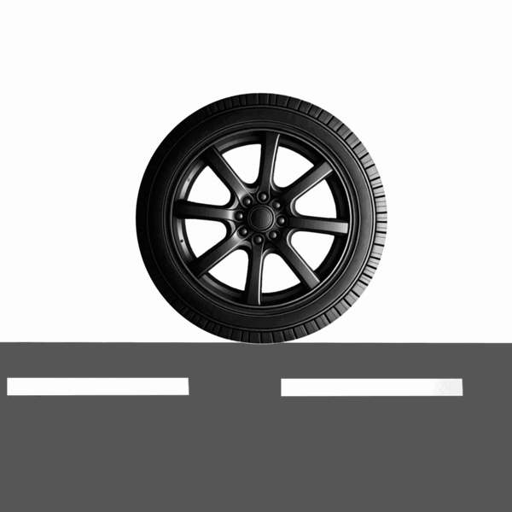
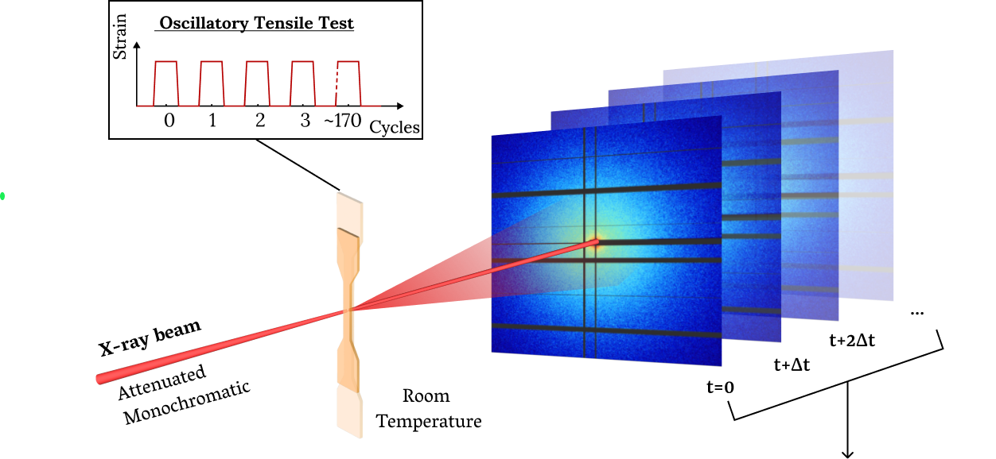
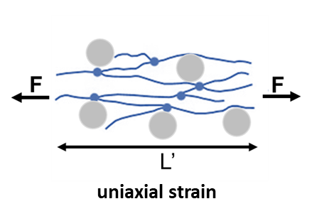
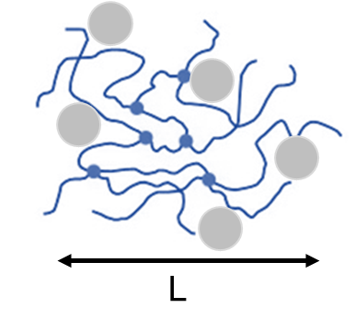
In operando X-ray Photon Correlation Spectroscopy (XPCS)
Static structural information
(SAXS)
Mimic driving
conditions
Continuous oscillatory
test for 1 h
Strain applied
Strain removed
XPCS founding: Network structure is irreversibly rearranged during successive deformation under Payne effect
“Degree of correlation”
over time (XPCS)
Structural correlation
Notes:
To mimic the real driving conditions.
Rubber samples were set for a series of cyclic tensile strains for 1hr under room temperature, meanwhile, a hard and coherent x-ray beam transmitted through the rubber samples, scattered to form speckle patterns
we got the spaced-averaged structural information on silica for each cycle from SAXS. The XPCS allows us to observe temporal fluctuations in the scattering intensity of coherent X-rays to see the correlations over time

Slide 5
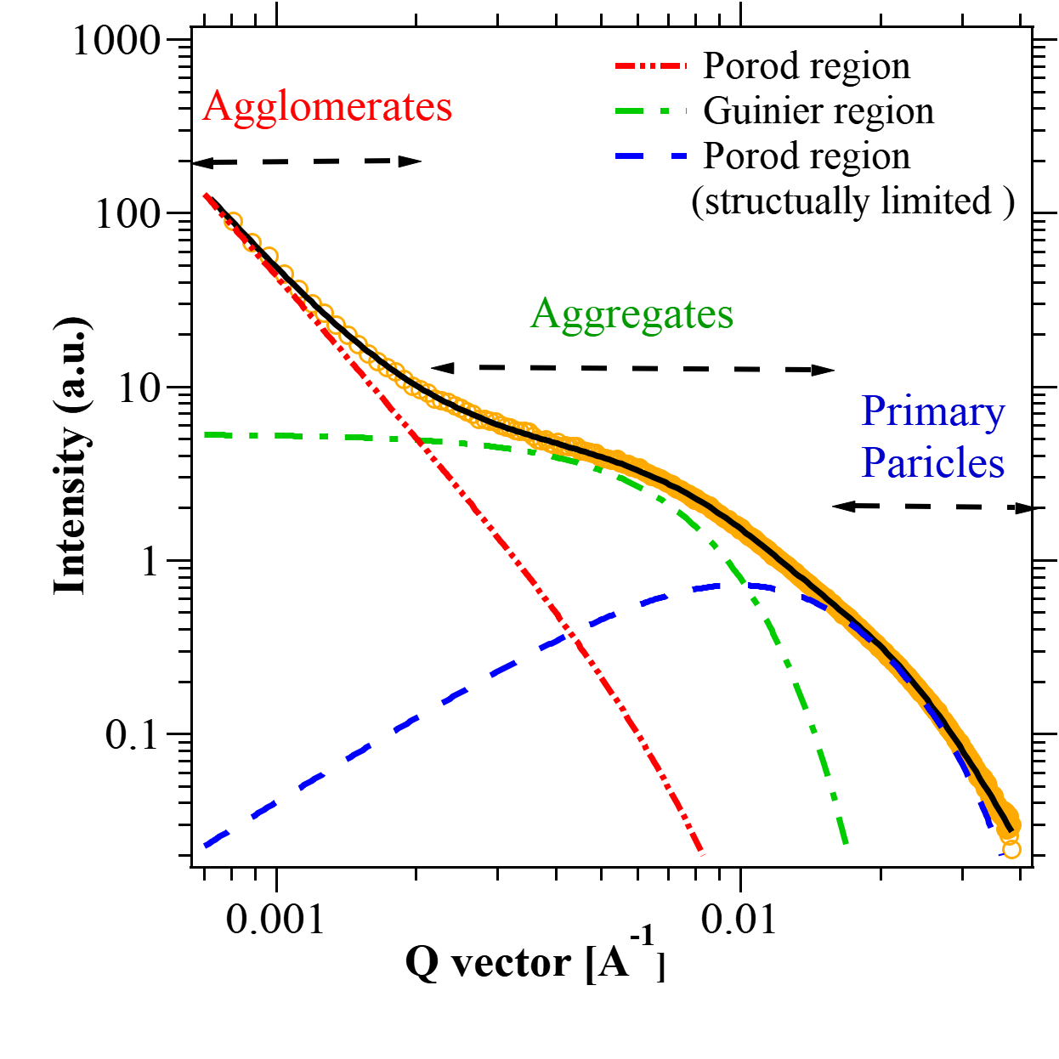
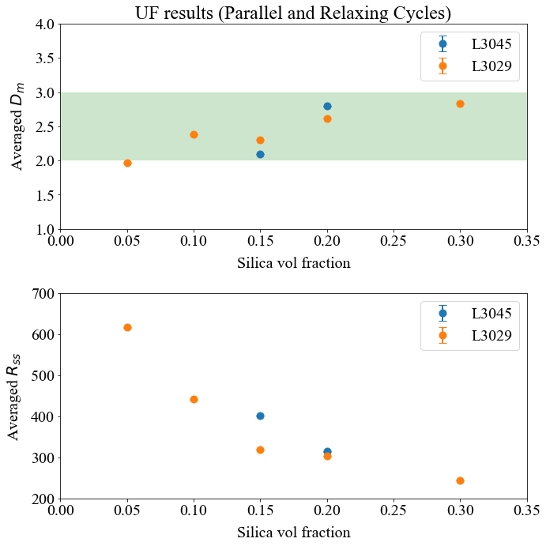
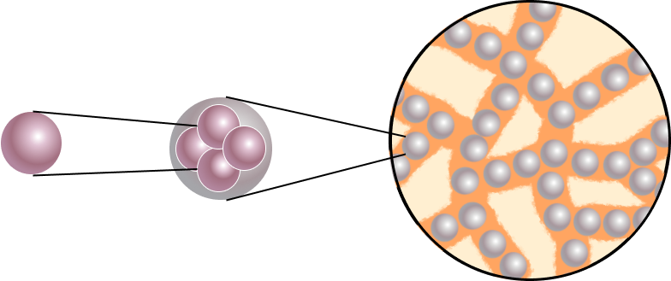
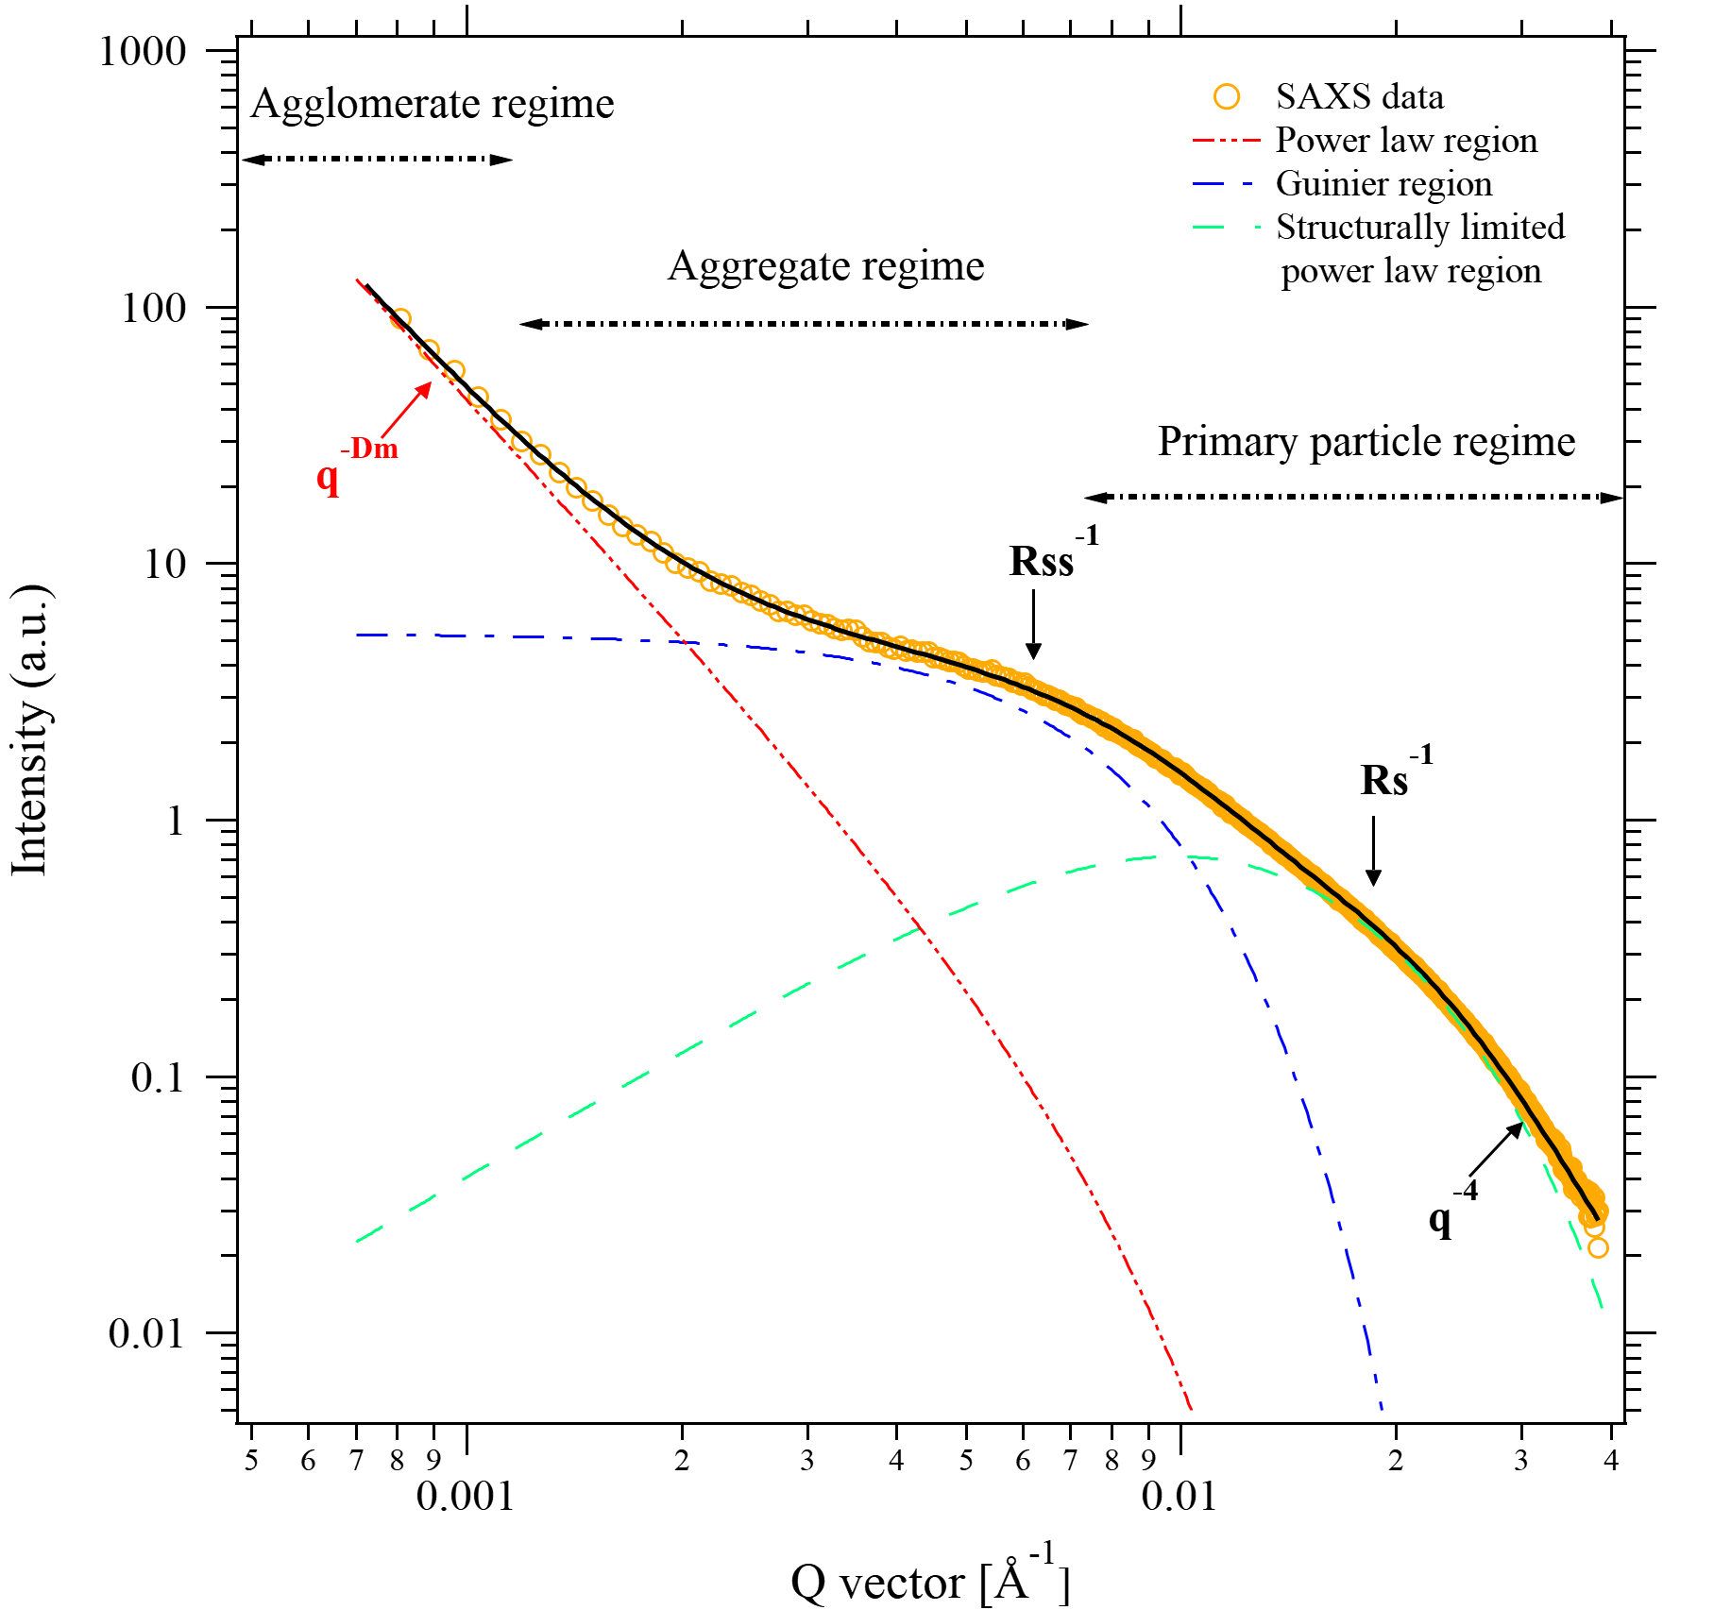
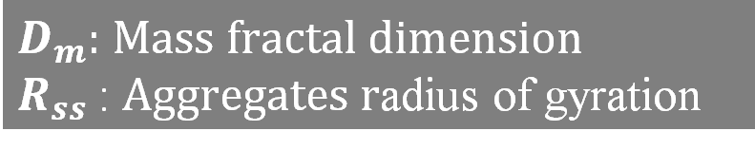
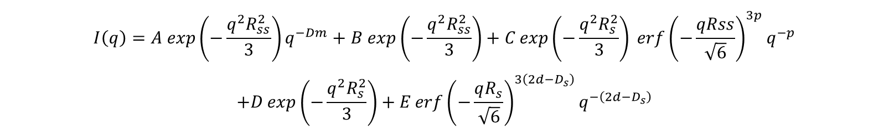
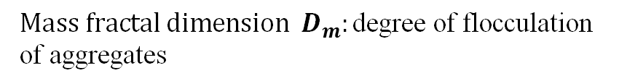
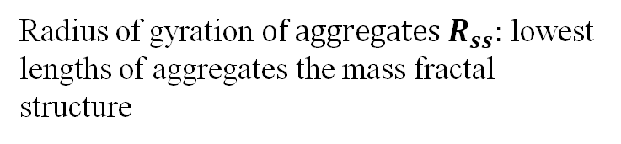
Structural analysis using Small-Angle X-ray Scattering
Unified (UF) equation
$$Mass fractal dimension { D}_{m}:\text{degree} \text{of} \text{flocculation} \text{of} \text{aggregates}$$
$$I\left(q\right)=A exp\left(−\frac{q^{2}R_{ss}^{2}}{3}\right)q^{−Dm}+B exp\left(−\frac{q^{2}R_{ss}^{2}}{3}\right)+C\exp\left(−\frac{q^{2}R_{s}^{2}}{3}\right) \operatorname{erf}{{\left(−\frac{qRss}{\sqrt{6}}\right)}^{3p}}q^{−p}$$
$$+D\exp\left(−\frac{q^{2}R_{s}^{2}}{3}\right)+E\operatorname{erf}{{\left(−\frac{qR_{s}}{\sqrt{6}}\right)}^{3\left(2d−D_{s}\right)}q^{−\left(2d−D_{s}\right)}}$$
Radius of gyration$of aggregates{ R}_{ss}:$ lowest lengths of aggregates the mass fractal structure
Koga et al, Macromolecules, 2008
$D_{m}:$ $Mass fractal dimension$
$R_{ss}$: $Aggregates r$adius of gyration
Or use this
Primary particle
(Rs=85Å)
Aggregate
(R_{ss} = ?)
Mass-Fractal Agglomerate (D_{m} = 1-3)
Primary particle
Aggregate
Non-Mass Fractal Agglomerate (D_{m} > 3)
Notes:
We used the UF equation as a mathematical model to interpret SAXS profiles
The Unified equation is particularly well-suited for studying hierarchical structures due to its ability to capture information across different length scales.

Slide 6
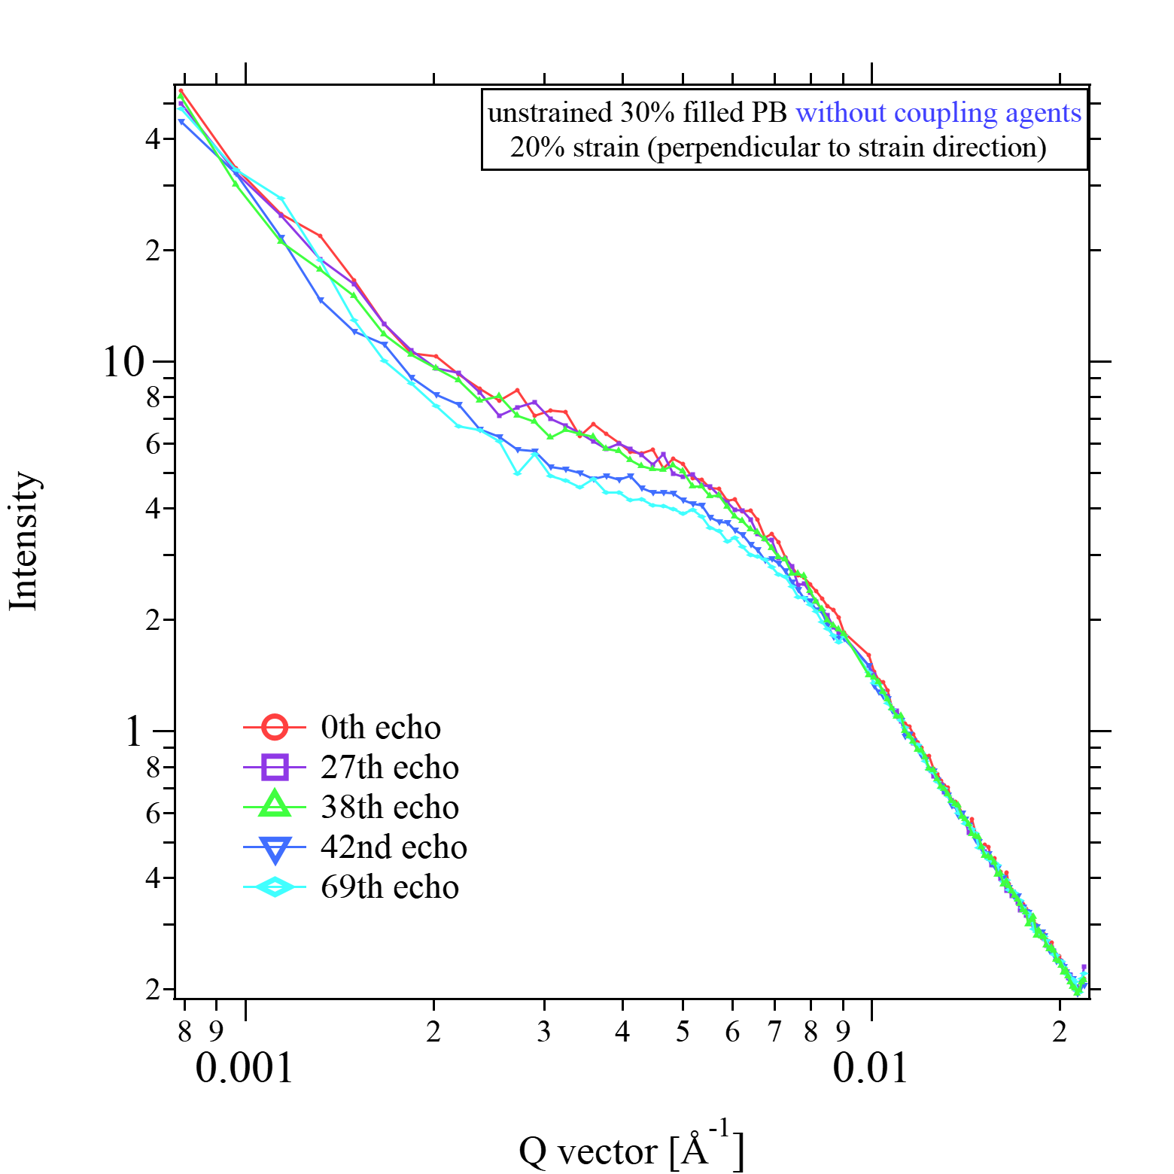
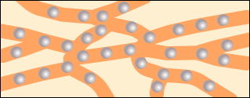
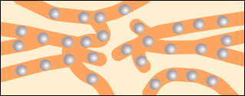
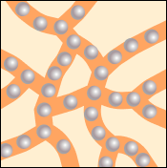
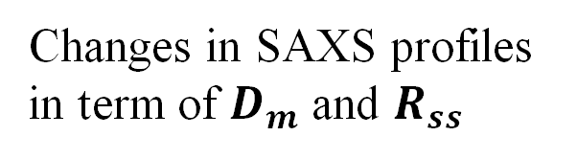
Changes in SAXS profiles in term of $D_{m}$ and $R_{ss}$
Before
After
F
F
Irreversible deformation
F
F
strain removed
strain applied

Slide 7
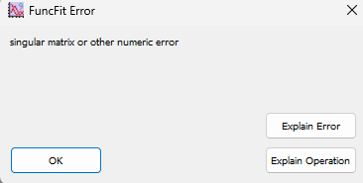
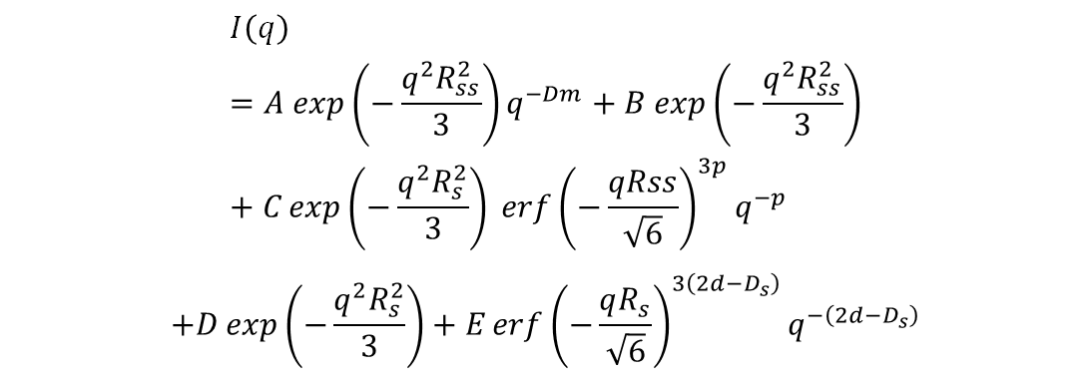
Challenges
Unified (UF) equation
Complex fitting model
10 variables
Need good constraints/initial guess
Time consuming
Fitting ~170 SAXS curve for each experiment
Plotting
$$I\left(q\right)=A exp\left(−\frac{q^{2}R_{ss}^{2}}{3}\right)q^{−Dm}+B exp\left(−\frac{q^{2}R_{ss}^{2}}{3}\right)+C\exp\left(−\frac{q^{2}R_{s}^{2}}{3}\right) \operatorname{erf}{{\left(−\frac{qRss}{\sqrt{6}}\right)}^{3p}}q^{−p}$$
$$+D\exp\left(−\frac{q^{2}R_{s}^{2}}{3}\right)+E\operatorname{erf}{{\left(−\frac{qR_{s}}{\sqrt{6}}\right)}^{3\left(2d−D_{s}\right)}q^{−\left(2d−D_{s}\right)}}$$

Slide 8
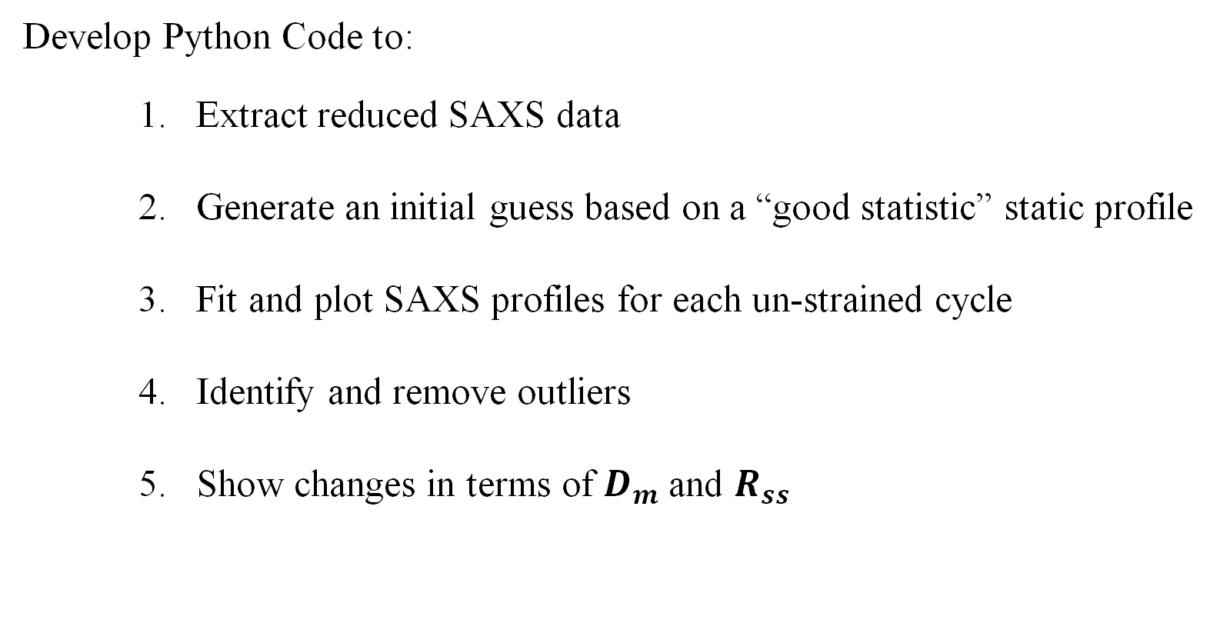
Approaches
Develop Python Code to:
Extract reduced SAXS data
Generate an initial guess based on a “good statistic” static profile
Fit and plot SAXS profiles for each un-strained cycle
Identify and remove outliers
Show changes in terms of $D_{m}$ and $R_{ss}$

Slide 9
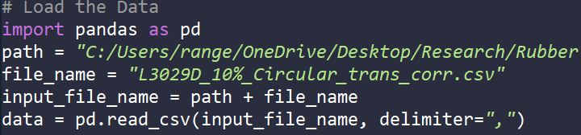
Data extraction

Slide 10
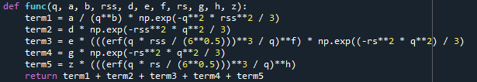
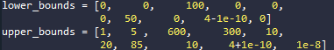
Define UF equation
Set upper/lower bounds
Fractal dimension: 0-5
Silica filler size: 50-85 Å
Surface fractal dimension: ~4 (smooth)
Contribution from particles are small

Slide 11
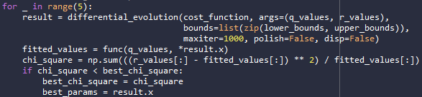
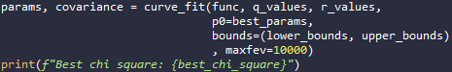
Obtain initial guess
Differential Evolution from scipy.optimize
Differential Evolution: optimization algorithm
Randomly generate candidate solutions
Mutate 1 variable at a single time
Evaluated by cost function: Chi-square test
Replace with mutant vector
Obtain the final solution
Curve fit from scipy.optimize
Notes:
It is used to find the global minimum of a multivariable function, which can be non-linear and non-differentiable. DE is particularly well-suited for optimization problems that involve a large number of variables and complex landscapes

Slide 12
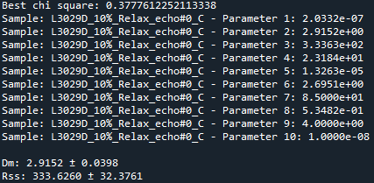
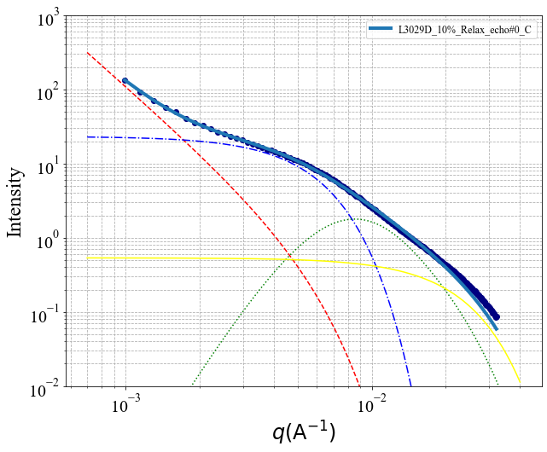
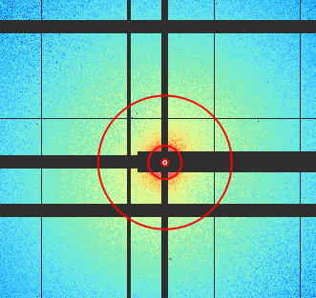
Static sample Results
Plot by matplotlib
Primary particle
(Rs=85Å)
Aggregate
(R_{ss} = 333Å)
Mass-Fractal Agglomerate (D_{m} = 2.9)

Slide 13
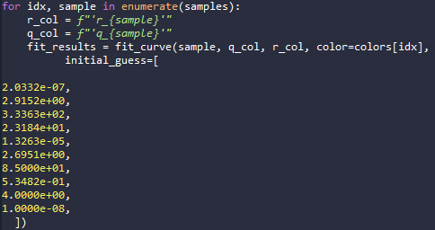
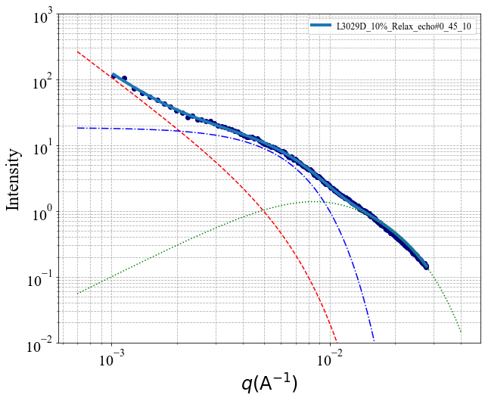
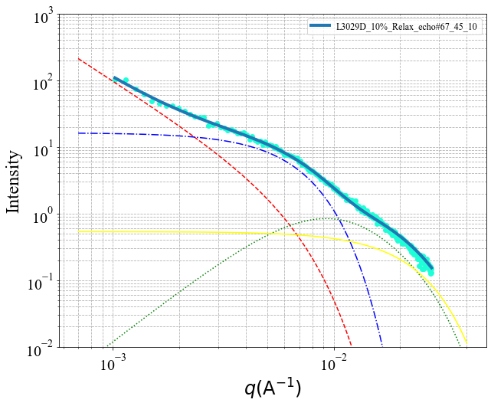
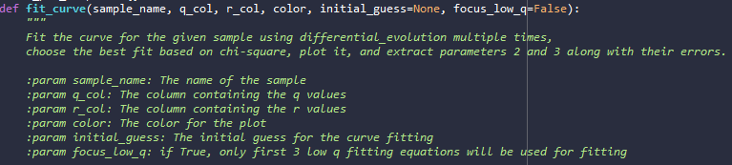
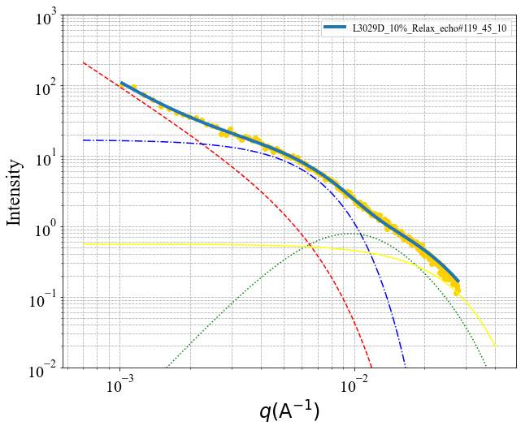
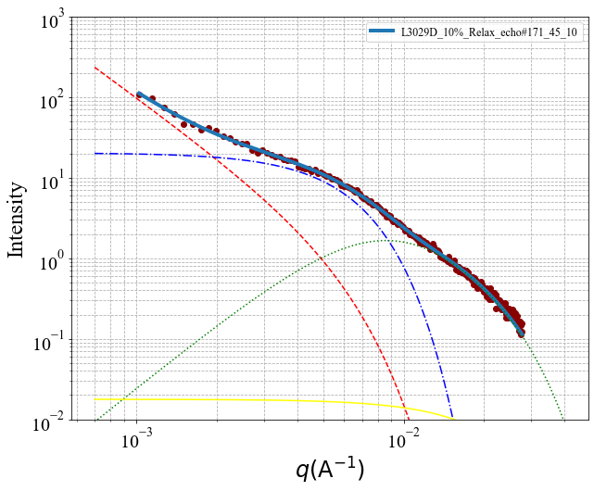
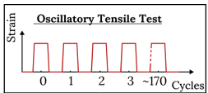
Oscillated Sample Results under Payne effect
Unstrained sample/ Parallel to the 10% strain direction
0th Cycle
67th Cycle
119th Cycle
171st Cycle

Slide 14
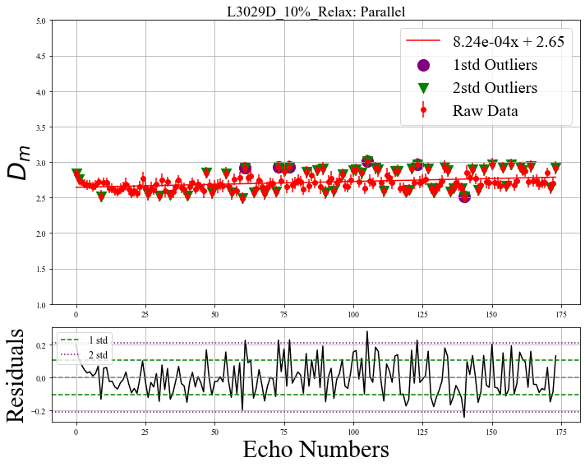
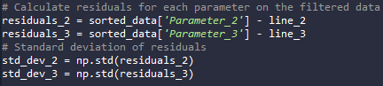
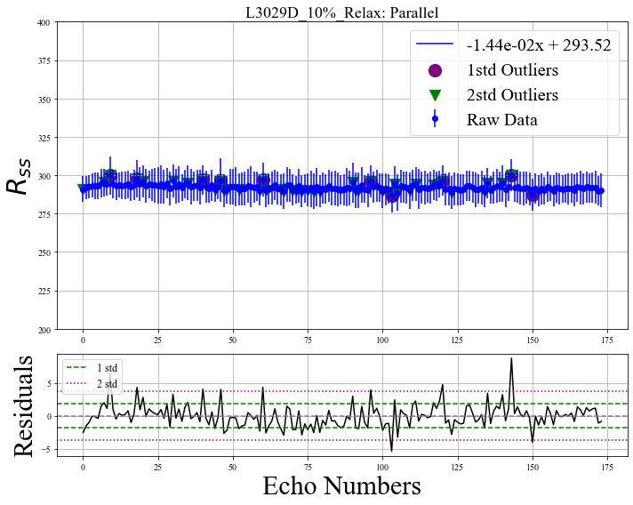
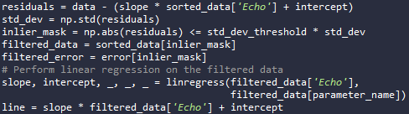
Identify and remove outliers
linear regression
residue and standard deviation
remove outliers and refit

Slide 15
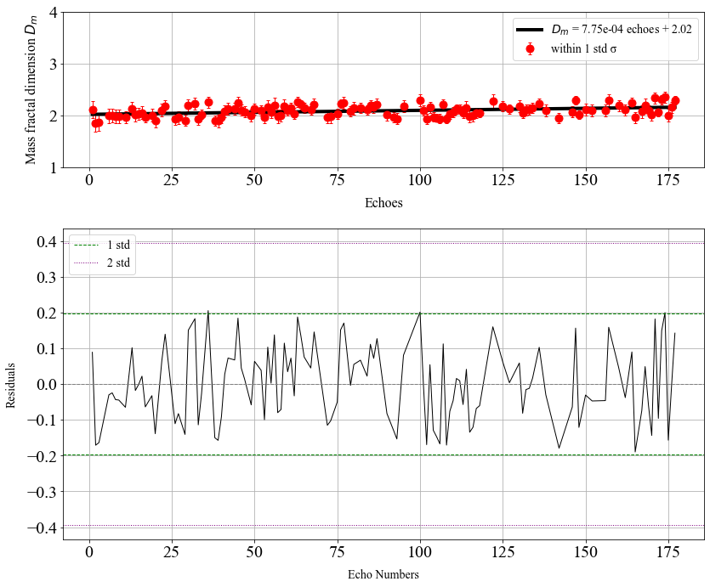
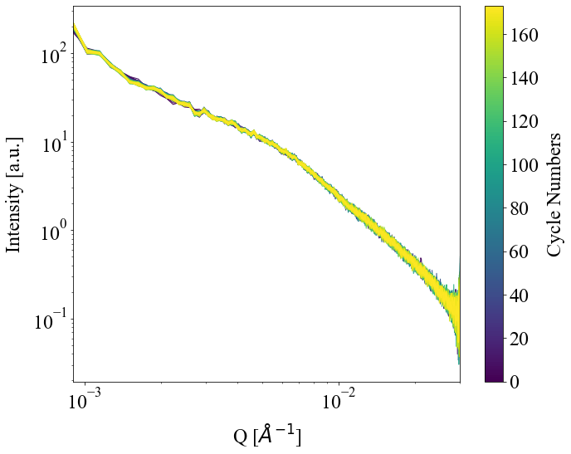
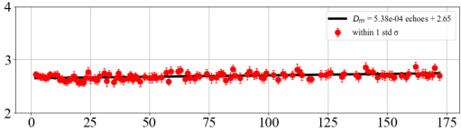
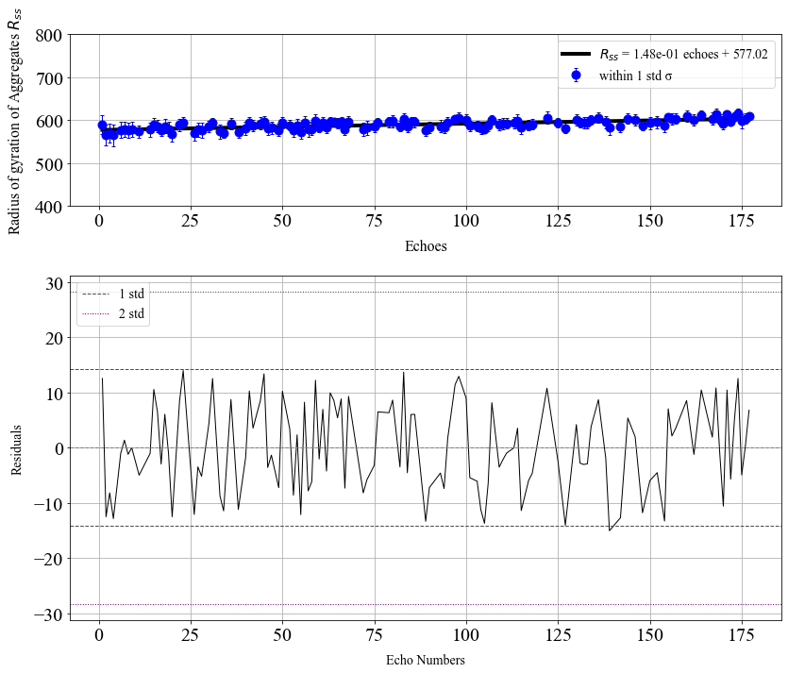

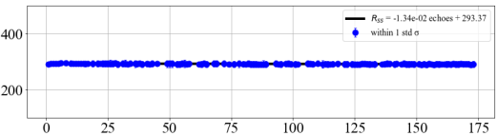







SAXS results for Network sample at 10% strain
Not adding this?
$D_{m}:$ $Mass fractal dimension$
$$q^{−Dm}$$
$$R_{ss}^{−1}$$
D_{m}=2$.65±0.02$
Parallel direction
D_{m}
Cycles
Payne effect
>10% strain
$R_{ss}$: Radius of gyration$of aggregates$
Payne effect has occurred at strain >1%
R_{ss}=2$93±10Å$
Cluster
R_{ss}
Cycles
NO significant strain-induced structural change was observed even at 10% strain over cycles in parallel direction.
Notes:
When we looked at our SAXS results for network sample under 10% strain where the payne effect already occurs,
Over 170 cycles, no significant structural change was obeserved in term of Dm and Rss

Slide 16
Conclusions
Small-Angle X-ray Scattering (SAXS) is a powerful tool for investigating the intrinsic structural properties of hierarchical materials.
However, its inherent time- and space-averaging characteristics may limit its effectiveness in observing local changes
Although the average structure of agglomerates (Network) remains unchanged, local structural variations still occur during oscillation. (from XPCS studies)
These local changes could potentially explain the Payne effect.

Slide 17
References
Fu, W., & Wang, L. (2016). Research on Payne effect of natural rubber reinforced by graft‐modified silica. Journal of Applied Polymer Science, 133(36). https://doi.org/10.1002/app.43891
Koga, T., Tanaka, F., Motokawa, R., Koizumi, S., & Winnik, F. M. (2008). Theoretical modeling of associated structures in aqueous solutions of hydrophobically modified Telechelic PNIPAM based on a neutron scattering study. Macromolecules, 41(23), 9413–9422. https://doi.org/10.1021/ma800957z
Rogers, M. C., Chen, K., Andrzejewski, L., Narayanan, S., Ramakrishnan, S., Leheny, R. L., & Harden, J. L. (2014). Echoes in X-ray speckles track nanometer-scale plastic events in colloidal gels under shear. Physical Review E, 90(6). https://doi.org/10.1103/physreve.90.062310

